Slide 1




Color Image Augmentation
Methods
by Nimesh Gautam

Slide 2



DATA ANALYTICS
KATHMANDU UNIVERSITY
Contents
  Augmentation Intro
  Types of Augmentation
  Color Augmentation
  Popular libraries, Benchmark
  Code Demonstration

Slide 3
DATA ANALYTICS
KATHMANDU UNIVERSITY
Augmentation
  Transforming of data.
  Generate new variations of existing data
  Improve Results and prevents Overfitting
  Computationally expensive process

Slide 4

DATA ANALYTICS
KATHMANDU UNIVERSITY
Image Data
Augmentation
Deep Learning
Approaches
Basic Image
Manupulations
Color Space
Transformations
Kernel
Filters
Sharpen
Blur,etc
Random
Erasing
Unclear Images
Mixing Images
Geometric
Tranformations
Fliping
Rotations,etc
Source: Shorten, C., Khoshgoftaar, T.M. A survey on Image Data Augmentation for Deep Learning. J Big Data 6, 60 (2019). https://doi.org/10.1186/s40537-019-0197-0

Slide 5

DATA ANALYTICS
KATHMANDU UNIVERSITY
Color Augmentation
Image =
Tensor (height x width x color channels)
  Isolating single colour from R, G, B
  Brightness, Contrast , HSV, RGB
  Changing colour histogram intensity
values (advance)
  To Grayscale

Slide 6
DATA ANALYTICS
KATHMANDU UNIVERSITY
Popular Libraries
  Albumentations
  ImageDataGenerator , Keras
  OpenCV
  PIL
  Scikit-Image

Slide 7
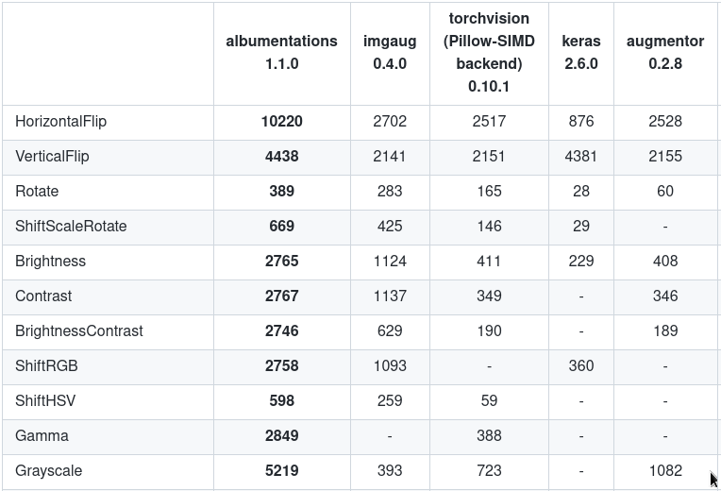
DATA ANALYTICS
KATHMANDU UNIVERSITY
BenchMark
Source: https://github.com/albumentations-team/albumentations#benchmarking-results

Slide 8

DATA ANALYTICS
KATHMANDU UNIVERSITY
CODE DEMONSTRATION

